Slide 1


Slide 2

Beyond the Valley Tourism Management System

Slide 3

INTRODUCTION OF PROJECT
Give here the introduction of your project in a professional way with proper headings. Try to write in bullets form. You can cover about two slides on introduction.

Slide 4
Provide Here the Diagram of Process Model. You can make the diagram of process model according to your choice but it should be correct.

Slide 5
Use Case Diagram
Provide Use Case Diagram of your Application here

Slide 6
Business Rules Catalog
Write down here some core business rules/functional requirements of your project.

Slide 7
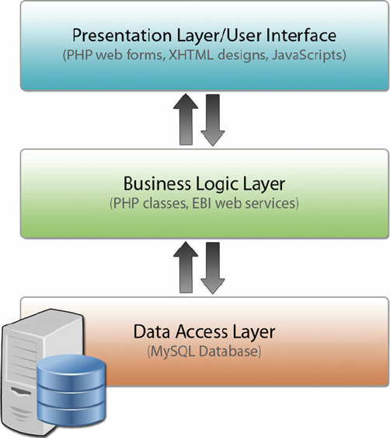
Architectural Design

Slide 8
Team Structure
Provide here the diagrammatic view of your team structure and key responsibilities.

Slide 9
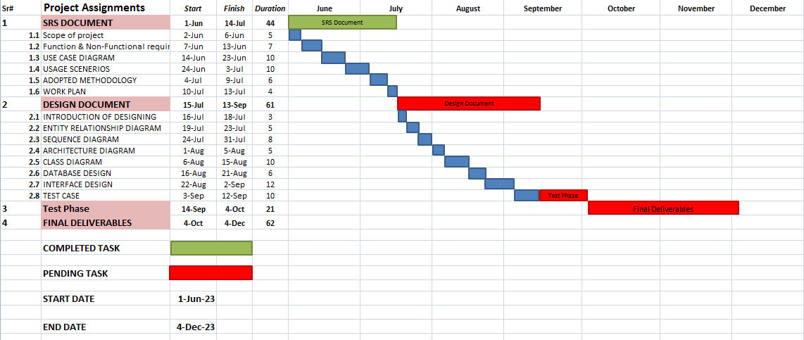
Project Schedule

Slide 10
Sequence Diagrams
Provide some core sequence diagrams here. Provide one diagram per slide and give heading at top for each sequence diagram.

Slide 11
Logical Model/Class Diagram

Slide 12
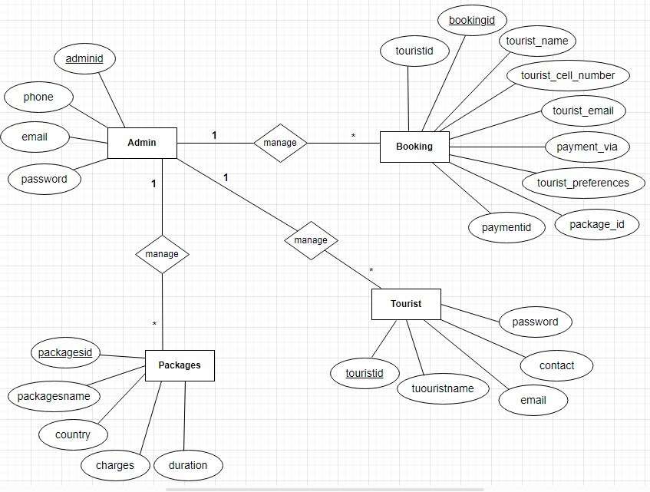
Entity-Relationship Diagram

Slide 13
Database Diagram

Slide 14
User Interfaces
Provide screen shots of GUI in different slides of your application here

Slide 15
Tools
HTML, CSS, Javascript As front end programming language
Php,MySQL as backend database
Microsoft Project
Microsoft Visio
Microsoft PowerPoint
Microsoft Word

